Slide 1

Customer Discovery
WEEK SIX
CEO: Rachel Evans
CTO: Sophie Tanker
CFO: Andra Buchan

Slide 2
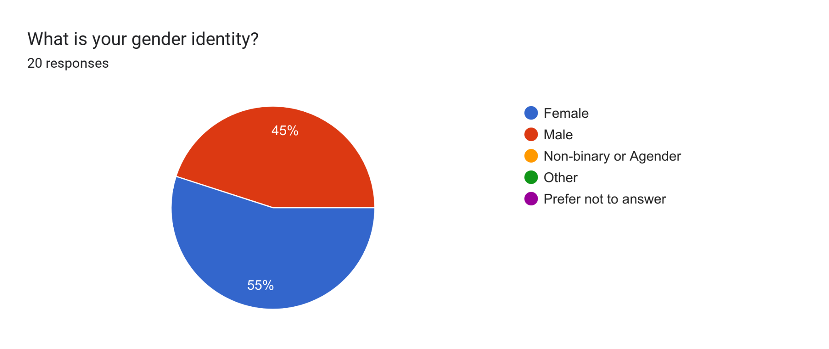
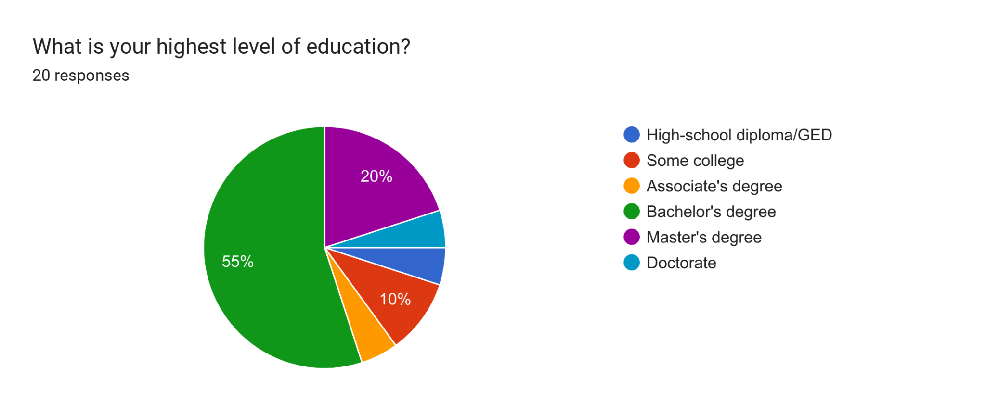
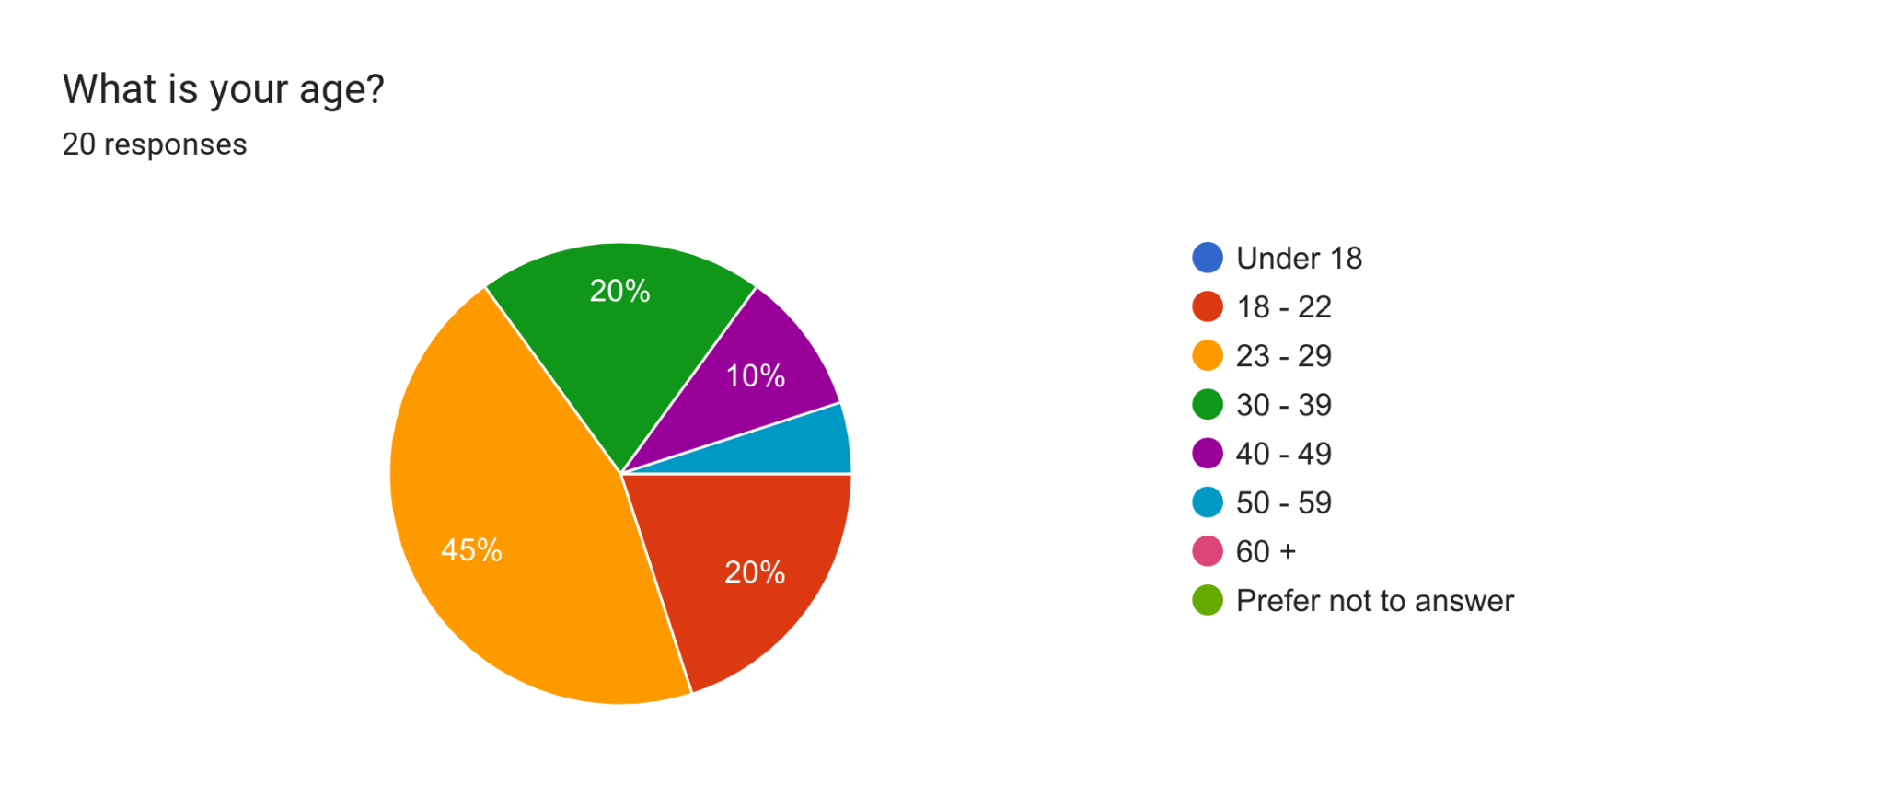
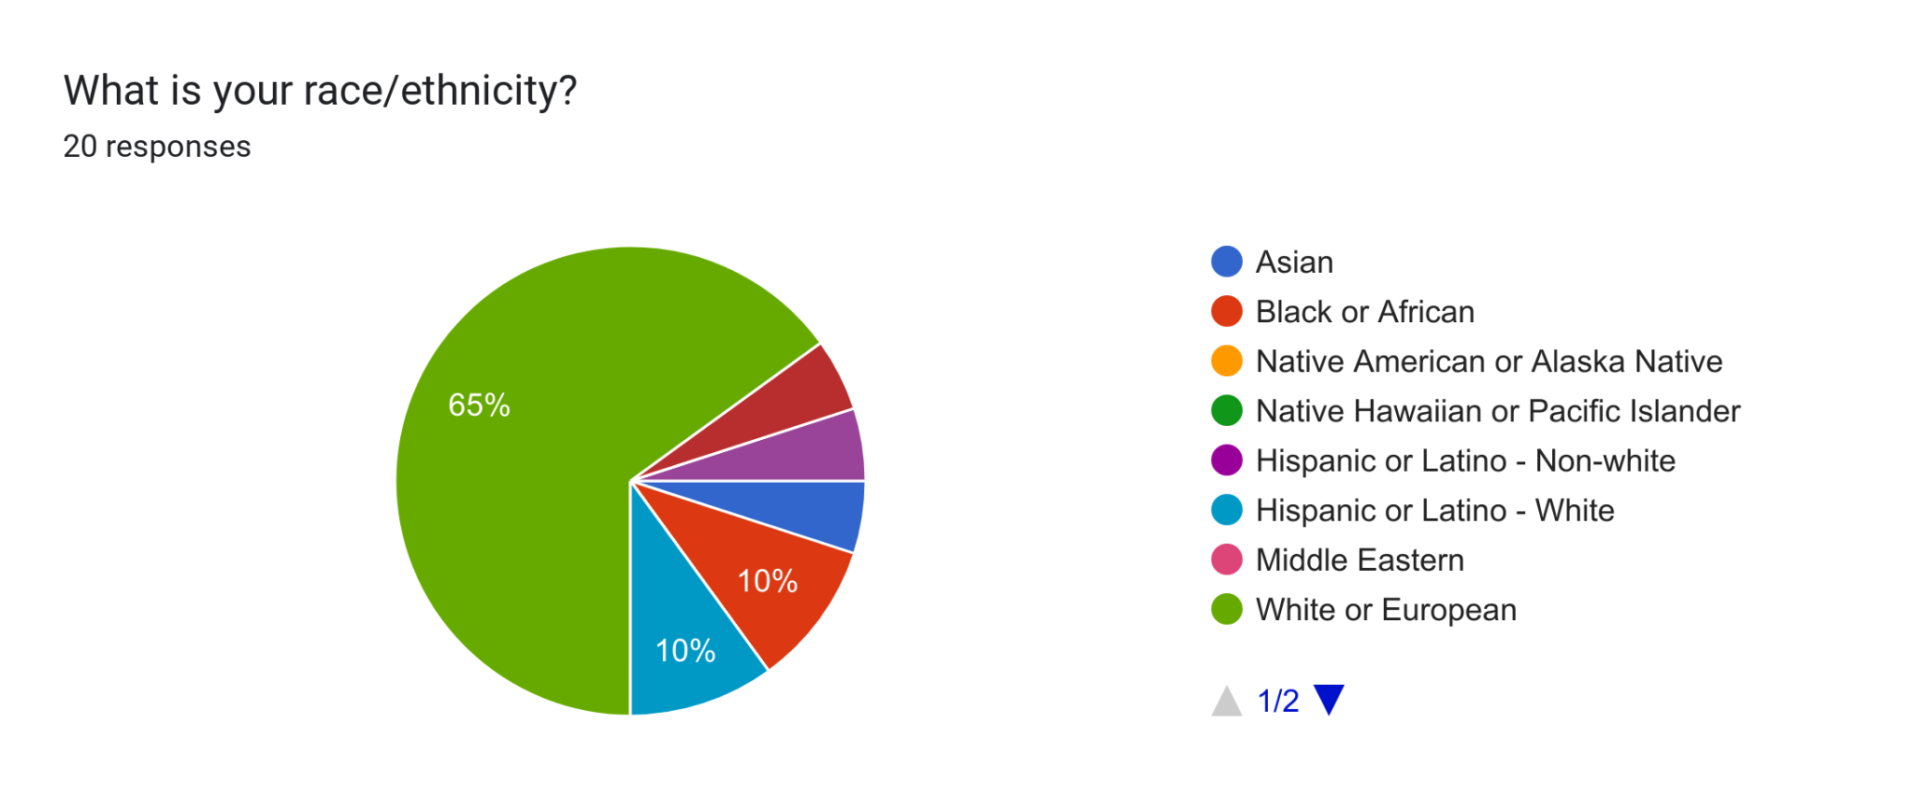
DEMOGRAPHIC INFORMATION

Slide 3
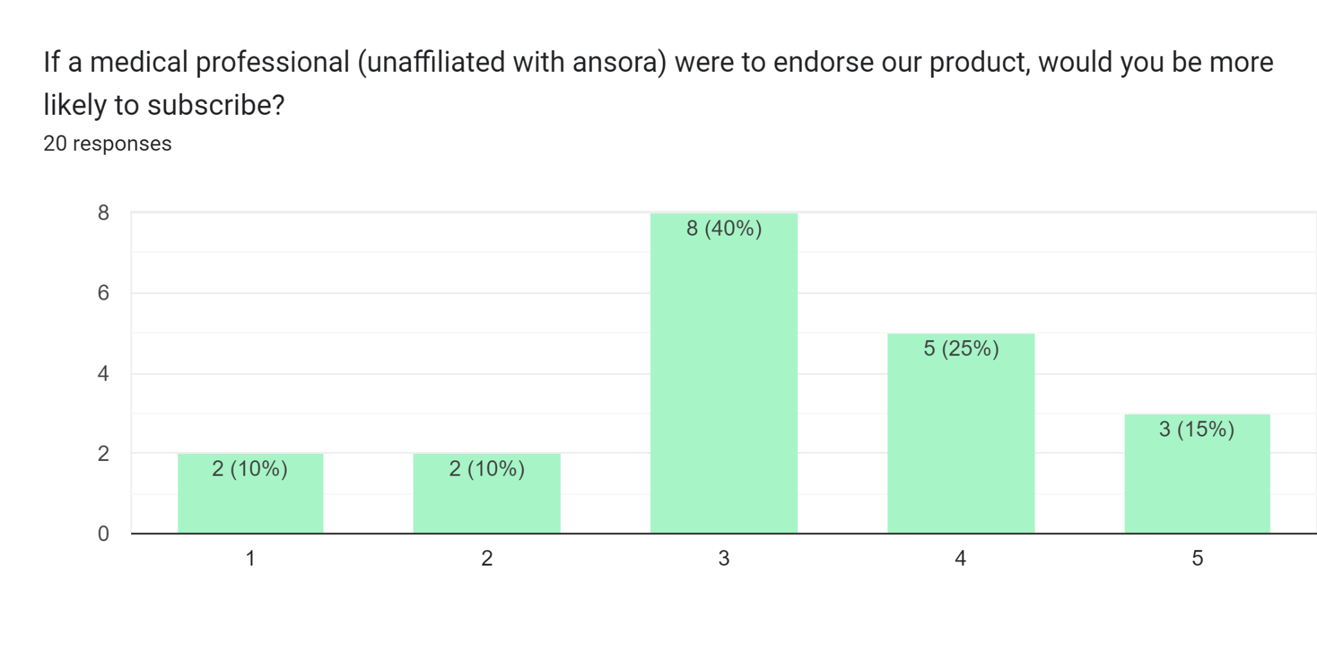
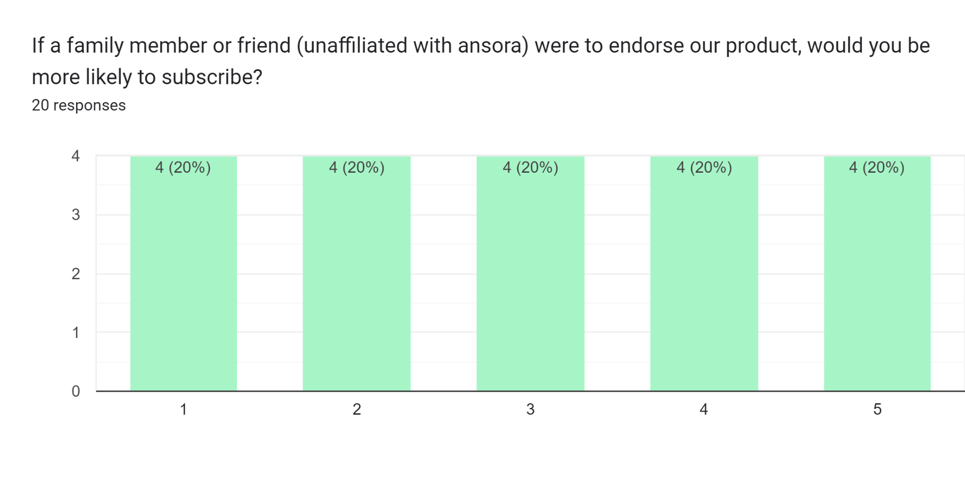
PRODUCT
ENDORSEMENT?
Medical professional
vs. family/friend

Slide 4

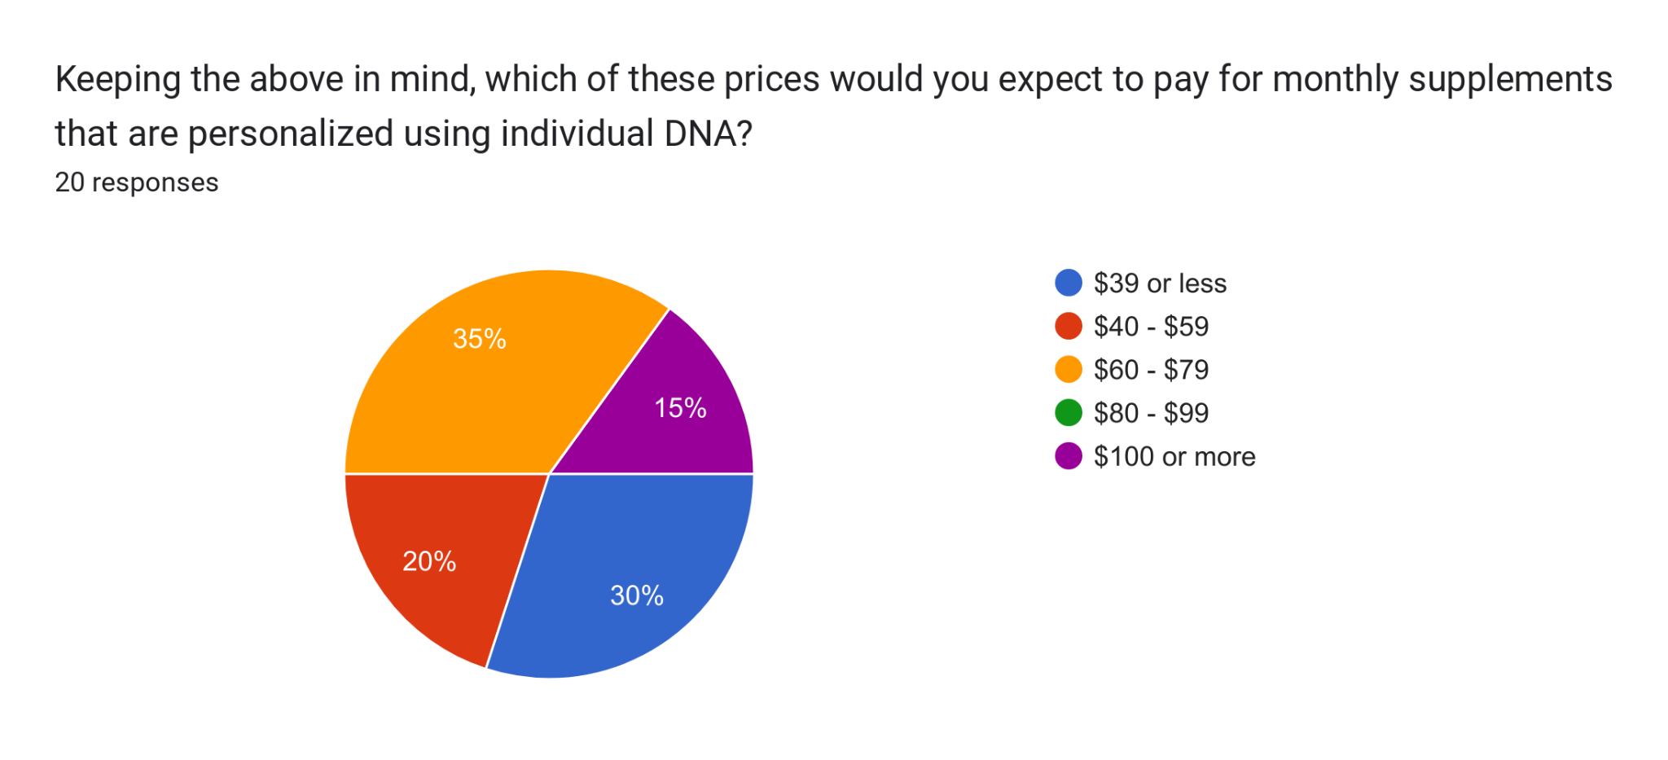
MONTHLY PRICE POINT
Supplement subscriptions that are currently on the market usually cost between $40 - $100 for each month of pills. These pills use consumer-reported data to inform supplement selection.

Slide 5
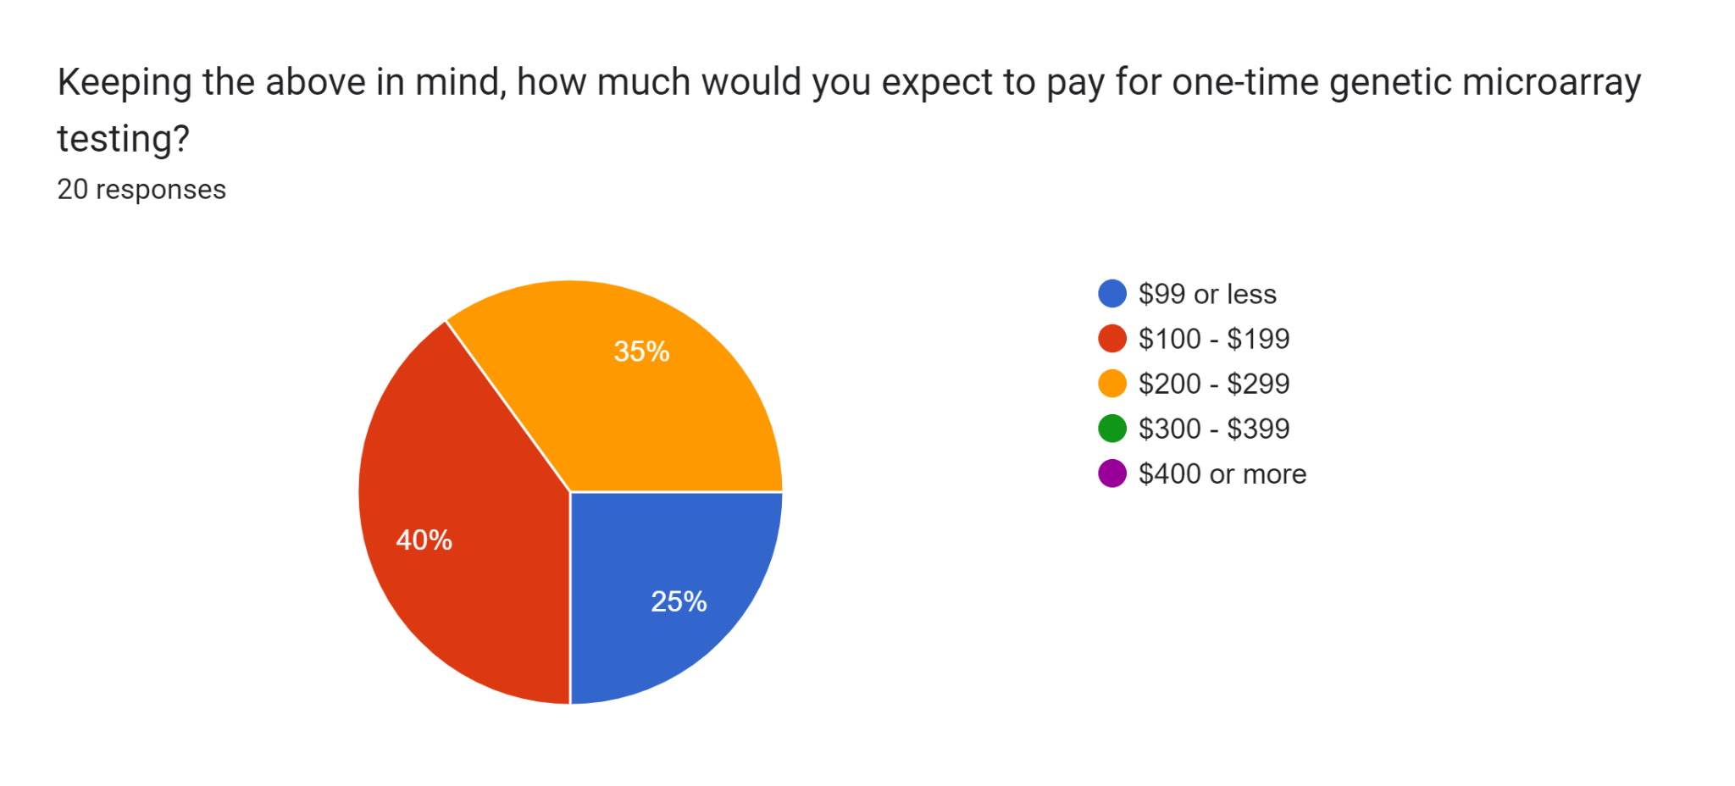
DNA TESTING PRICE POINT
DNA sampling currently on the market exists for a variety of reasons. Tracking ancestry, general health information, rare disease screening, confirming paternity, and even dog breed testing is readily available to consumers.
These tests are sold starting around $99, but depending on the specifics they can reach prices up to $899. The average price of these direct-to-consumer tests is $313.

Slide 6
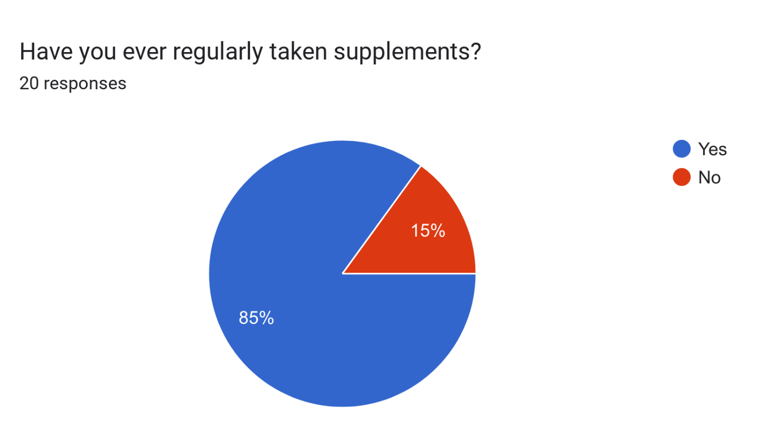
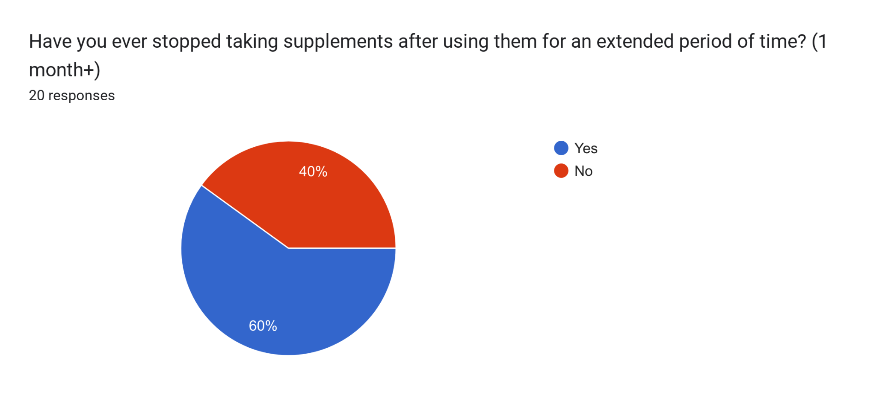
HAVE YOU STOPPED USING SUPPLEMENTS?

Slide 7
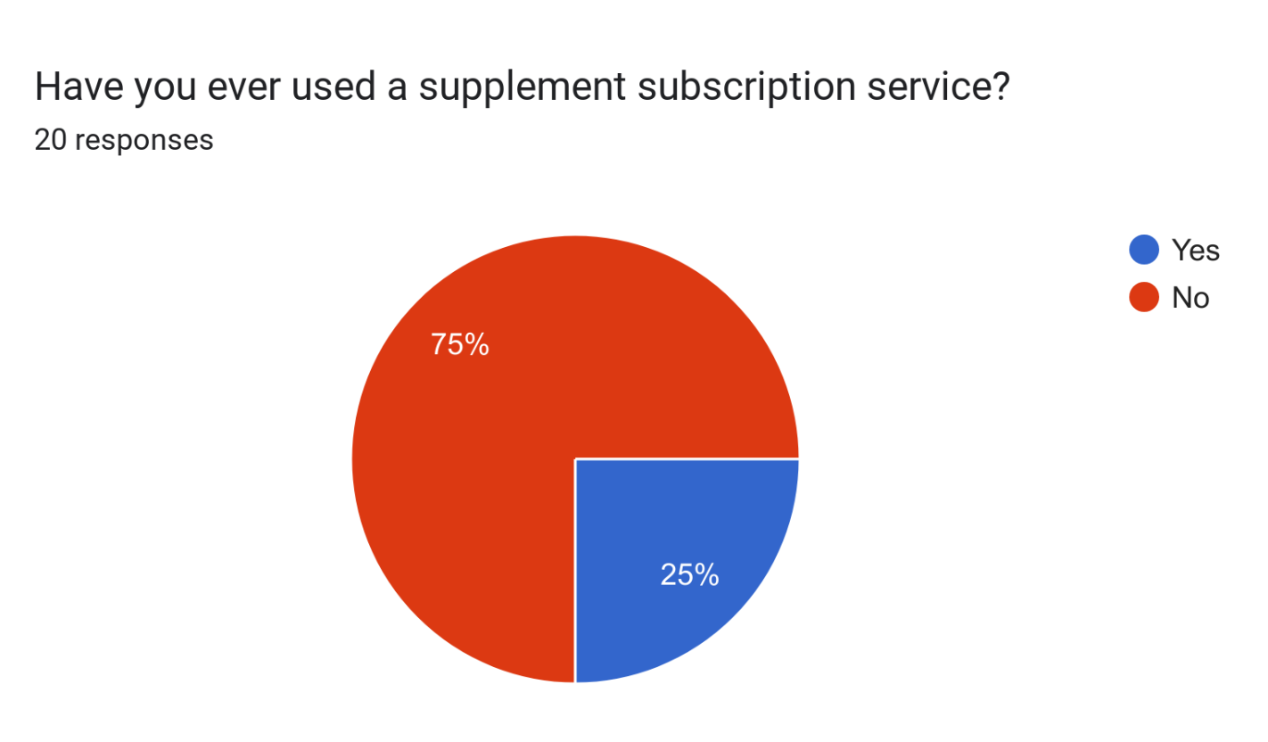
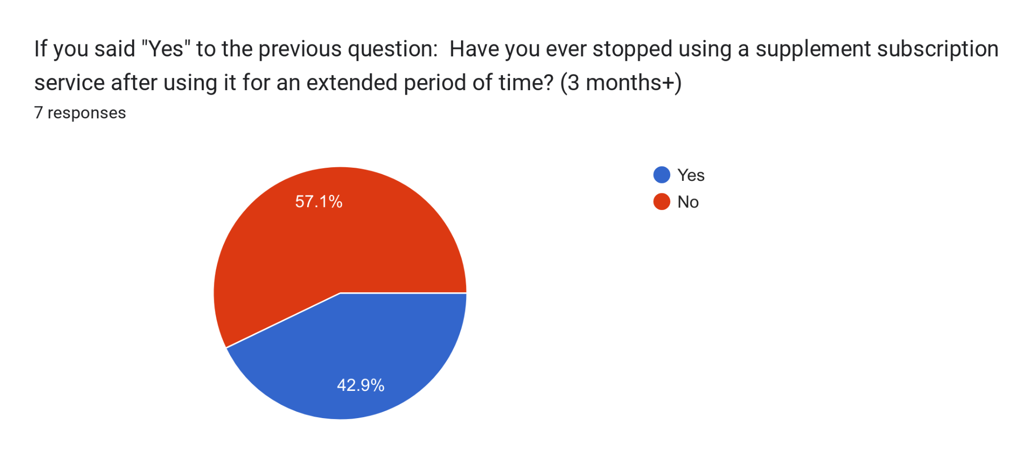
HAVE YOU STOPPED USING SUPPLEMENTS?

Slide 8
HAVE YOU STOPPED SUPPLEMENTS?
“Decided supplement wasn’t worth the expense”
“I didn’t feel it was any different to the supplements I already have”
“i dont like popping pills of any kind. Plus its hard to continue using something when you dont feel any effects after using for a while.”
“Too expensive and I ended up with too many”

Slide 9
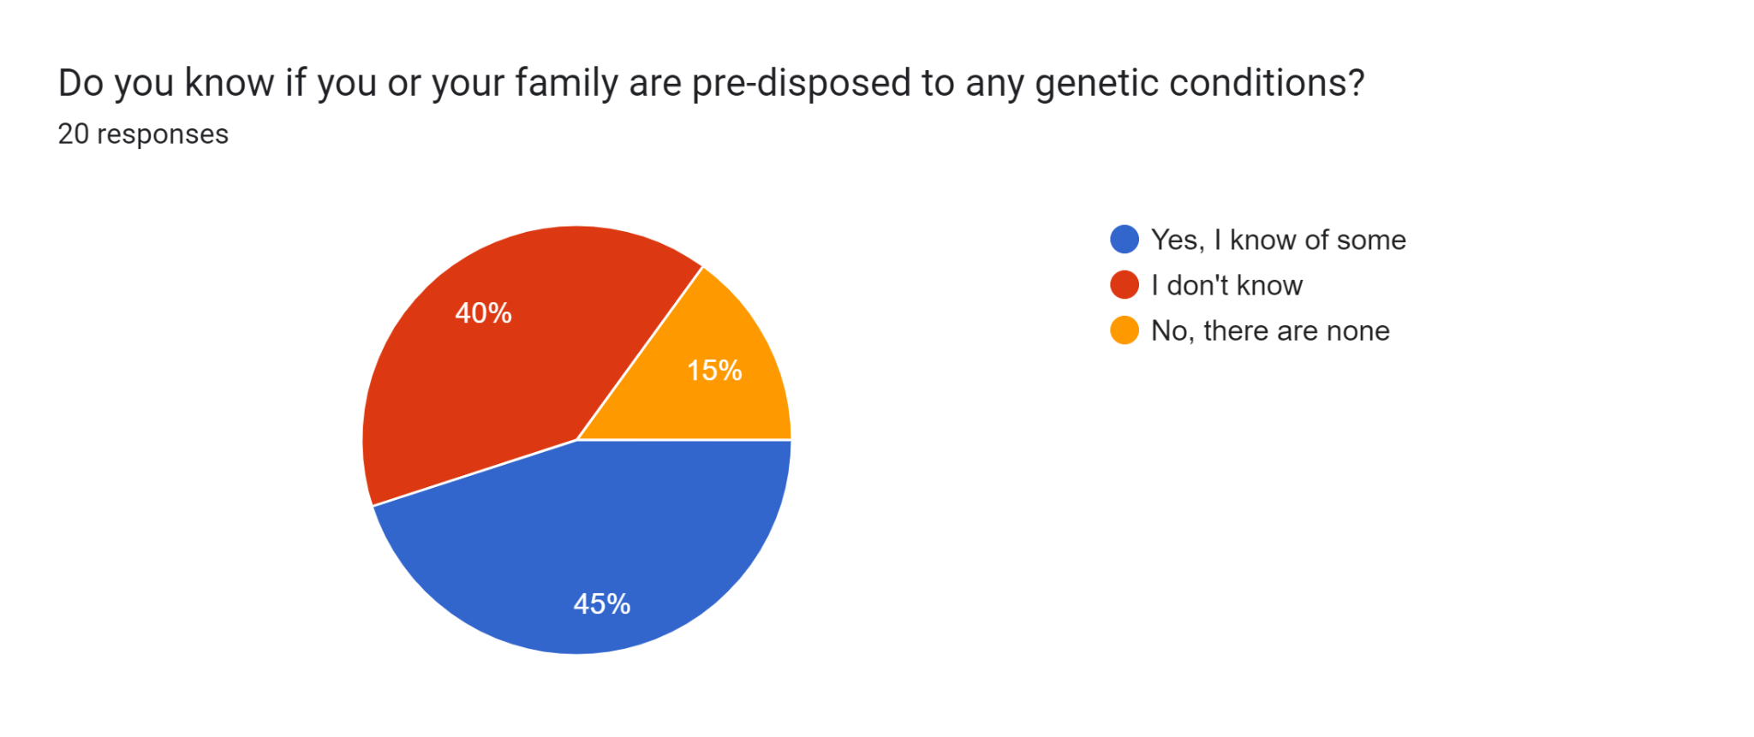
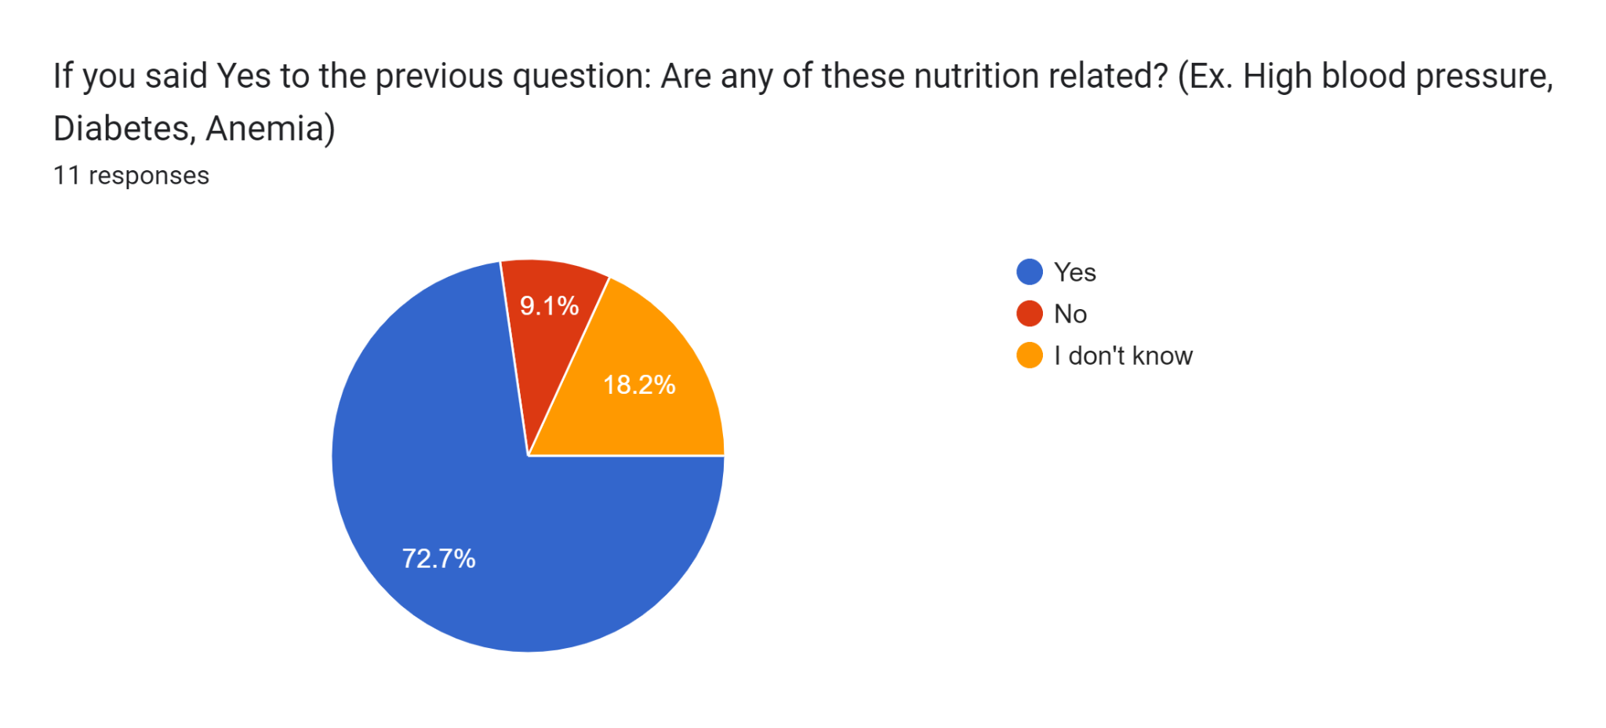
NUTRITION AND FAMILY HISTORY

Slide 10
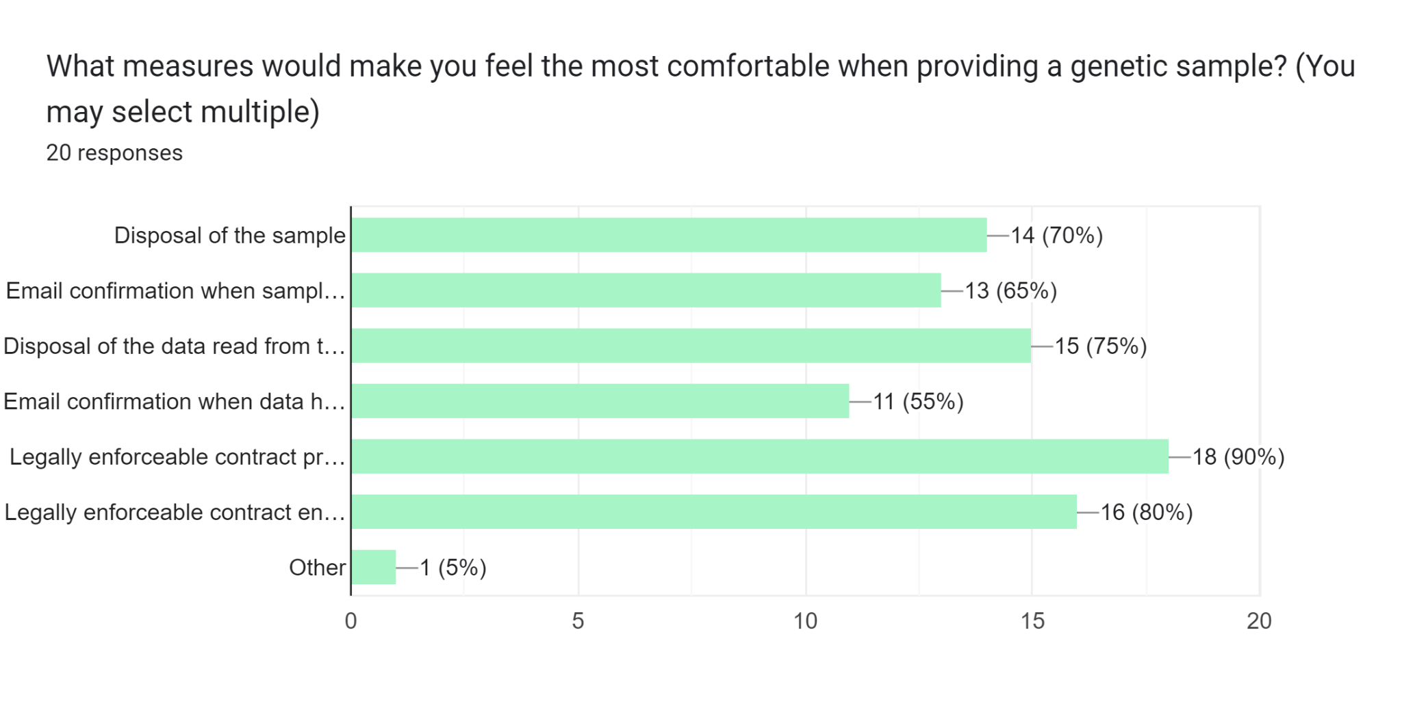
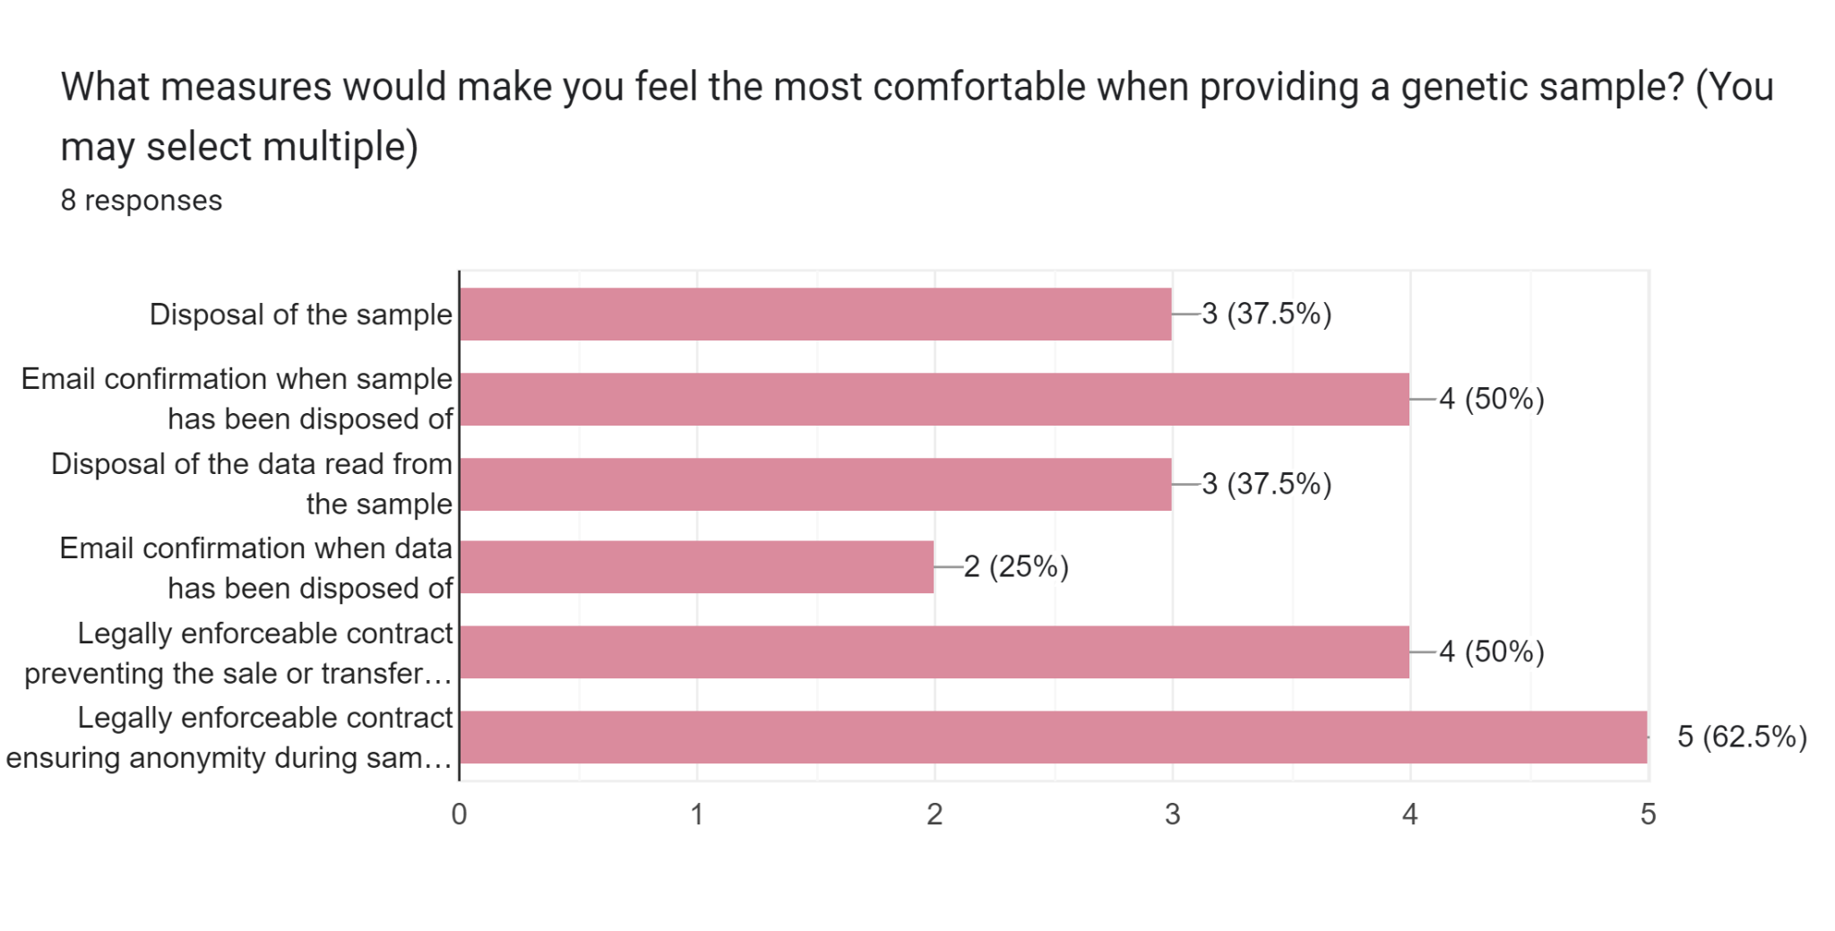
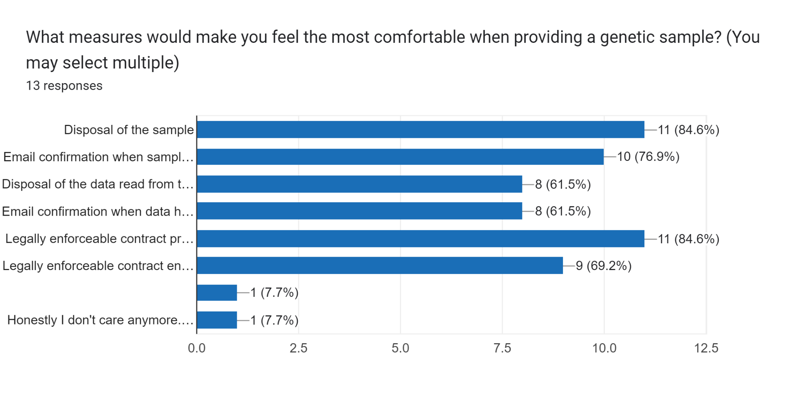
WOULD RESPONDENTS PROVIDE A DNA SAMPLE?
Most popular choices across three weeks:
Legally enforceable contract preventing the sale or transfer of genetic data
Disposal of the sample
Legally enforceable contract ensuring anonymity during sample processing

Slide 11
COMMENTS
I don't hate the use of vitamins for specific deficiencies. Stuffing everyone with vitamins randomly sounds not very scientific or ethical.
None of these would make me comfortable providing a genetic sample
I love the concept of your product! I would definitely look more into it since my family does have a history of high blood pressure (myself included).
Highly interesting topic, nice set of questions and scale nicely!! good job!

Slide 12
TAKEAWAYS
Monthly cost between $45 and $60
One-time DNA sampling cost between $100 and $200
Option to get supplements without genetic testing
Option for users to choose their own supplements

Slide 13
Questions?

